Slide 1
FUNDAMENTALS OF HARDWARE AND WINDOWS

Slide 2
CONTENT
Hardware Fundamentals
Operating System
Types of Operating System
Windows Kernel Architecture
Booting Process
Management Mechanism
File System
Device Management
Process Management
Memory Management

Slide 3
Block diagram for Computer
INPUT
CPU
OUTPUT
Storage

Slide 4
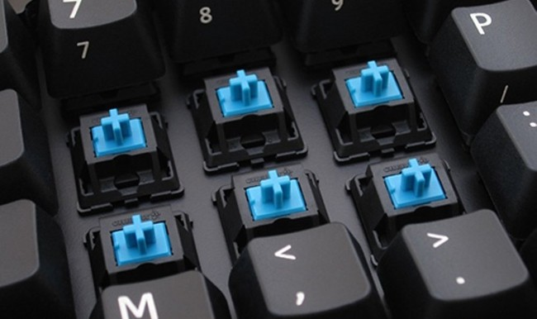
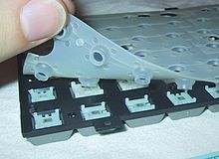
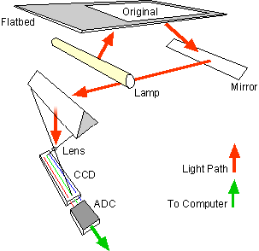
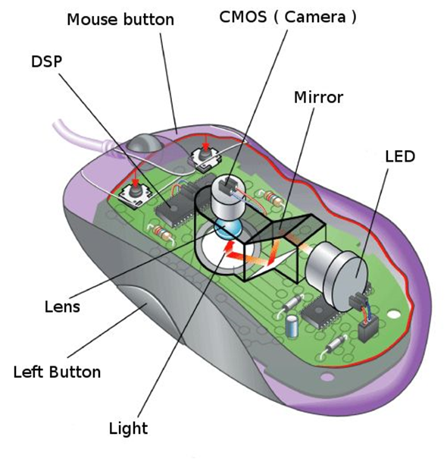
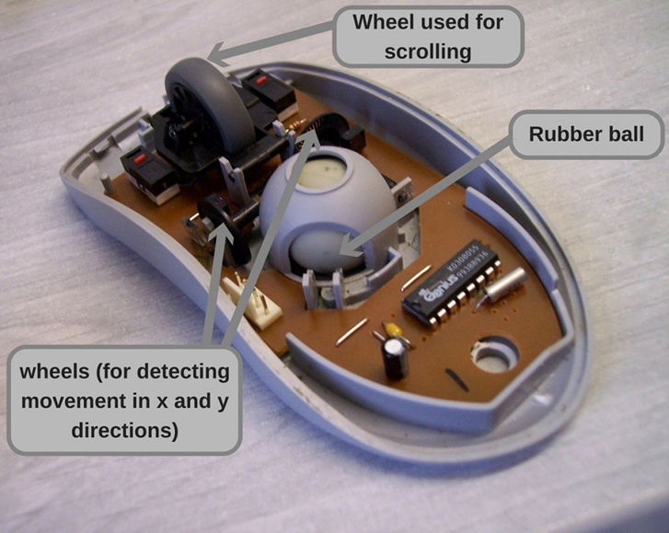
INPUT DEVICES
KEYBOARD
SCANNER
MOUSE
SCANNER

Slide 5
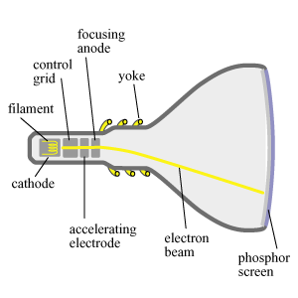
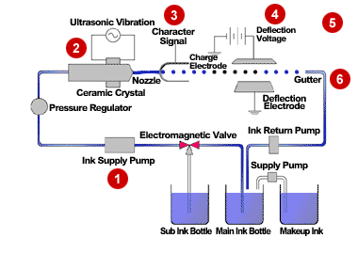
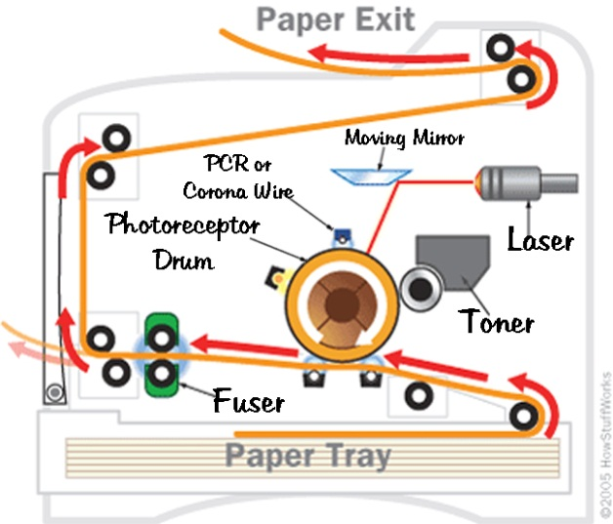
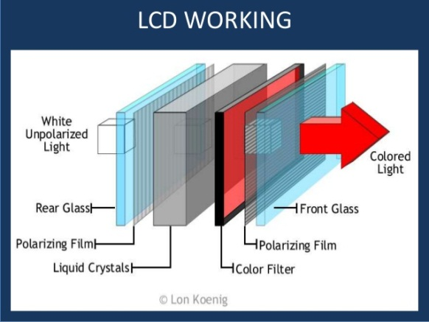
OUTPUT DEVICES
Monitors
Printers

Slide 6
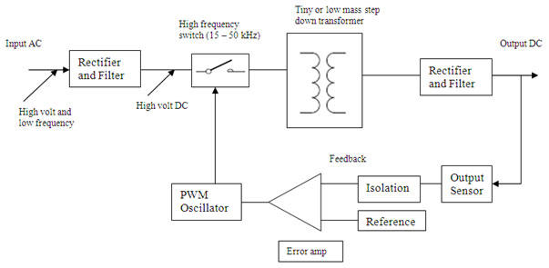
SMPS
USE: Switched-mode power supplies are used to power a wide variety of equipment such as computers, sensitive electronics, battery-operated devices and other equipment requiring high efficiency.

Slide 7
Motherboard:

Slide 8
Types of Memory
MEMORY
ROM
RAM
PROM
EPROM
EEPROM
SRAM
DRAM

Slide 9
STORAGE
OPTICAL
MAGNETIC

Slide 10
INTRODUCTION TO OPERATING SYSTEM

Slide 11
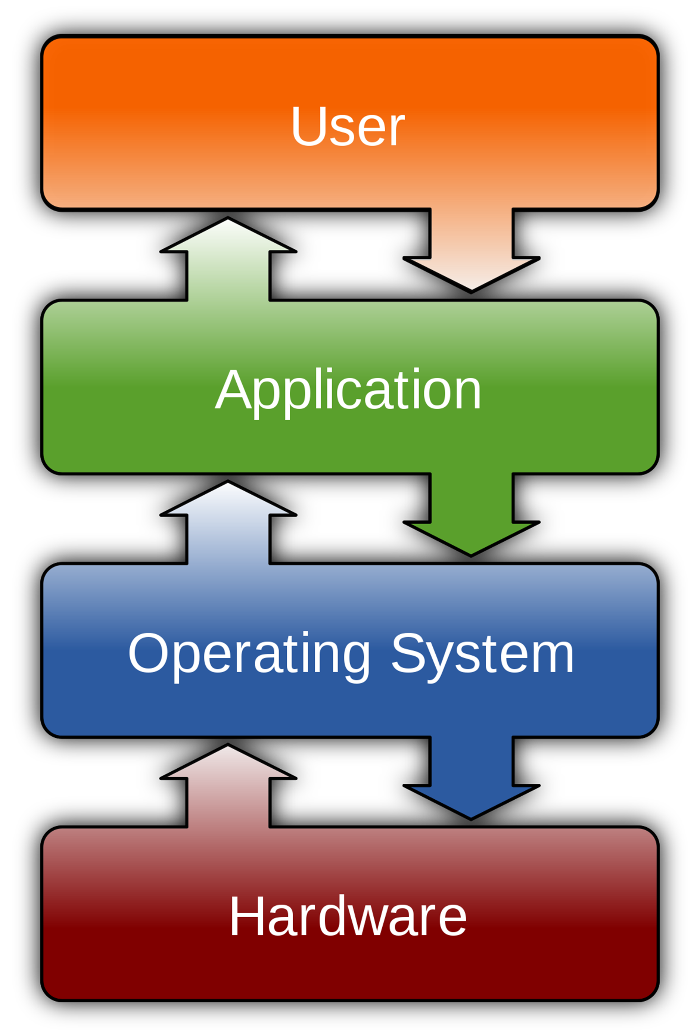
An operating system (OS) is system software that manages computer hardware and Application software resources and provides common services for computer programs.
operating system acts as an intermediary between programs and the computer hardware.
Example: Microsoft Windows, Linux, Unix, Mac.
Notes:
A cor AZUL sempre tem que aparecer no slide. Seja nas formas ou no texto.
Uma imagem como essa nao funciona. Muito “Barbie” para uma consultoria. Eles gostam deste layout mas deveria estar separador de capitulos com o logo de “espadas” maior. Para toda insercao de imagem o fundo deve ser cinza claro.

Slide 12
TYPES OF OPERATING SYSTEM
Network OS
Distributed OS
Real-Time OS
Multi-Tasking OS
Batch OS

Slide 13
WORKSTATION:
A workstation is a special computer designed different applications. Intended primarily to be used by one person at a time, they are commonly connected to a local area network and run multi-user operating systems.
Example: Windows XP.
SERVER:
Server operating system is designed to run on servers, that operate within client/server architecture to serve the requests of client computers on the network.
Example: Ubuntu.

Slide 14
WINDOWS KERNEL ARCHITECTURE

Slide 15
A kernel manages computer and the hardware - most notably memory and CPU time.
A computer user never interacts directly with the kernel. It runs behind the scenes and cannot be seen, except for the text logs that it prints.
Types :
A microkernel, which only contains basic functionality.
A monolithic kernel, which contains many drivers.
A hybrid kernel, attempts to combine aspects and benefits of microkernel and monolithic kernel architectures used in computer operating systems.

Slide 16
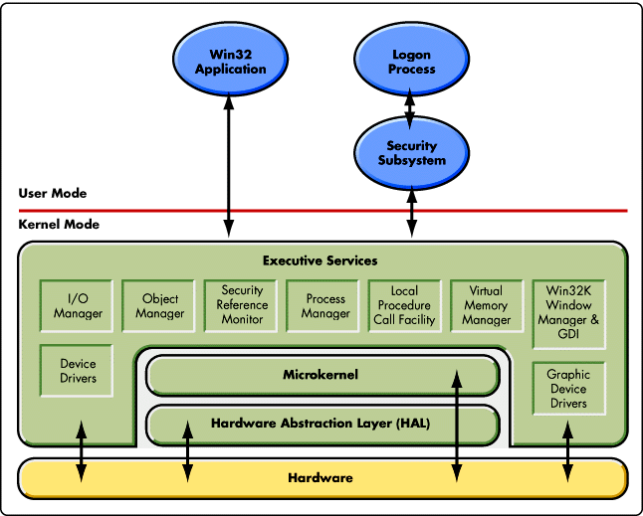

Slide 17
WINDOWS BOOTING PROCESS

Slide 18
SMPS
MBR
Processor
BIOS
Boot sector
POST
CMOS setting
446 bytes of executable codes
2bytes
P1
P2
P3
P4
(64 bytes)

Slide 19
Boot sector
Boot manager (bootmgr)
Boot Loader (winload.exe)
Loads Kernel
BCD
Phase 0 Loads Kernel Ntoskrnl.exe
Phase 1
Session manager sub system smss.exe
csrss.exe
Session 0
Session 1
Explorer Initialization

Slide 20
MANAGEMENT MECHANISM

Slide 21
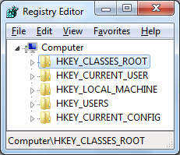
Windows Registry Editor
The Registry is a database used to store settings of Microsoft Windows.
It contains security information and settings for all the hardware, software, users, and preferences of the PC.
Whenever a user makes changes to a Control Panel settings, or File Associations, System Policies, or installed software, the changes are reflected and stored in the Registry.
Notes:
A cor AZUL sempre tem que aparecer no slide. Seja nas formas ou no texto.
Uma imagem como essa nao funciona. Muito “Barbie” para uma consultoria. Eles gostam deste layout mas deveria estar separador de capitulos com o logo de “espadas” maior. Para toda insercao de imagem o fundo deve ser cinza claro.

Slide 22
Hives
Key
Key
Value
Sub key
Sub key
Value

Slide 23
WINDOWS SERVICES
Windows Time :
- Maintains date and time synchronization on all clients and servers in networks.
Windows Update :
- Enables the detection, download and installation of updates for windows.
Windows Firewall :
- Windows Firewall helps protect your computer by preventing unauthorized user from gaining access to your computer through the Internet or network.
Notes:
A cor AZUL sempre tem que aparecer no slide. Seja nas formas ou no texto.
Uma imagem como essa nao funciona. Muito “Barbie” para uma consultoria. Eles gostam deste layout mas deveria estar separador de capitulos com o logo de “espadas” maior. Para toda insercao de imagem o fundo deve ser cinza claro.

Slide 24
FILE SYSTEM

Slide 25
File:
File is a collection of organized and structured data.
A File is a collection of data stored in one unit, identified by a file name.
It can be document, picture, audio, video, application.
File System:
Way of storing and organizing a drive.
It specifies what type of info. Can be attached to files like filenames, permissions, attributes.
Its used to control how data is stored and retrieved.
Notes:
A cor AZUL sempre tem que aparecer no slide. Seja nas formas ou no texto.
Uma imagem como essa nao funciona. Muito “Barbie” para uma consultoria. Eles gostam deste layout mas deveria estar separador de capitulos com o logo de “espadas” maior. Para toda insercao de imagem o fundo deve ser cinza claro.

Slide 26
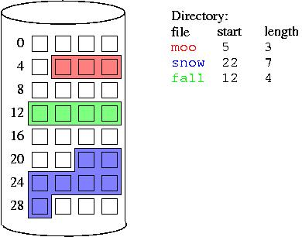
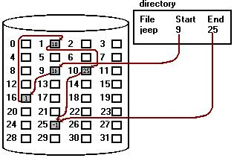
Allocation Methods:
Contiguous Allocation: location of a file is defined by the disk address of the first block and its length.
Linked Allocation: Each file is a linked list.
Notes:
A cor AZUL sempre tem que aparecer no slide. Seja nas formas ou no texto.
Uma imagem como essa nao funciona. Muito “Barbie” para uma consultoria. Eles gostam deste layout mas deveria estar separador de capitulos com o logo de “espadas” maior. Para toda insercao de imagem o fundo deve ser cinza claro.

Slide 27
Types of File System:
File Allocation Table (FAT)
New Technology File System (NTFS)

Slide 28
FILE ALLOCATION TABLE (FAT32):
FAT is a file system used by OS to locate files on a hard drive.
Quick Access to files.
Boot sector | FAT | FAT Copy | Files and Folders
Notes:
A cor AZUL sempre tem que aparecer no slide. Seja nas formas ou no texto.
Uma imagem como essa nao funciona. Muito “Barbie” para uma consultoria. Eles gostam deste layout mas deveria estar separador de capitulos com o logo de “espadas” maior. Para toda insercao de imagem o fundo deve ser cinza claro.

Slide 29
NEW TECHNOLOGY FILE SYSTEM (NTFS):
Boot sector | Master File Table( MFT) | Files | MFT Copy
In NTFS info is stored in terms of records.
It only supports windows formats.
Security is maintained by assigning NTFS permissions to files and folders.
The permissions can be assigned to individual files and folders.

Slide 30
FAT32 VS NTFS:
FAT32
NTFS
Encryption
Compression
Local security
Network security
Yes
Yes
Yes
Yes
No
No
No
Yes

Slide 31
DEVICE MANAGEMENT

Slide 32
Device Management:
In computing, a device driver is a computer program that operates or controls a particular type of device that is attached to a computer. A driver provides a software interface to hardware devices, enabling operating systems and other computer programs to access hardware functions without needing to know precise details of the hardware being used.
Device Controller:
A device controller is a part of a computer system that makes sense of the signals going to, and coming from the CPU. Any device connected to the computer is connected by a plug and socket, and the socket is connected to a device controller. It functions as a bridge between the device and the operating system. The electrical part of an I/O device is known as a device controller and can take the form of a chip on personal computers.
Notes:
A cor AZUL sempre tem que aparecer no slide. Seja nas formas ou no texto.
Uma imagem como essa nao funciona. Muito “Barbie” para uma consultoria. Eles gostam deste layout mas deveria estar separador de capitulos com o logo de “espadas” maior. Para toda insercao de imagem o fundo deve ser cinza claro.

Slide 33
Power Manager:
S0 | All the components uses full power
S1 (Light Sleep) | Power consumption greater than s2, less than s0.
S2 (Deep Sleep) | Power consumption greater than s3, less than s1.
S3 (Deepest Sleep) | Only one of the components is consuming power.
S4 (Hibernating) | Least amount of power is getting used.
S5 (Fully off) | No components are using power.

Slide 34
PROCESS MANAGEMENT

Slide 35
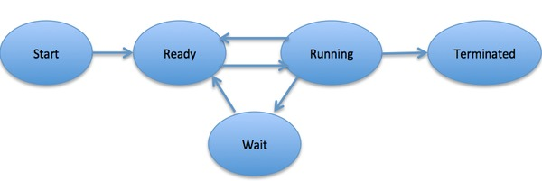
Process:
A process is a program in execution.

Slide 36
Multiprocessing:
-It is the use of two or more central processing units (CPUs) within a single computer system.
Multitasking:
-It has the same meaning of multiprogramming but in a more general sense, as it refers to having multiple (programs, processes, tasks, threads) running at the same time.
Multithreading:
-It is an execution model that allows a single process to have multiple code segments (i.e., threads) run concurrently within the “context” of that process.
Hyper-threading:
-It is a situation in which CPU is logically divided and threads are executed parallelly.

Slide 37
VIRTUAL ADDRESS & PHYSICAL ADDRESS

Slide 38
VIRTUAL MEMORY
Memory management capability of an OS that uses hardware and software to allow a computer to compensate for physical memory shortages by temporarily transferring data from random access memory (RAM) to disk storage
Freeing applications from having to manage a shared memory space
Increased security due to memory isolation
Use more memory than might be physically available

Slide 39
A VIRTUAL ADDRESS is a binary number in virtual memory that enables a process to use a location in primary storage (main memory) independently of other processes and to use more space than actually exists in primary storage by temporarily relegating some contents to a hard disk or internal flash drive.

Slide 40
PAGING
In computer operating systems, paging is a memory management scheme by which a computer stores and retrieves data from secondary storage for use in main memory.
In this scheme, the operating system retrieves data from secondary storage in same-size blocks called pages.
Paging is an important part of virtual memory implementations in modern operating systems, using secondary storage to let programs exceed the size of available physical memory.

Slide 41
THRASHING
Memory gets overcommitted
Access time of memory is as slow as disk
System spend all the time in reading and writing

Slide 42
THANK YOU
Surabhi Mishra
Pawankumar Chidurala
Oindrila Dey
Debayan Dutta
Nikitha Narahari
Saim Aktar

